Slide 1

CAPSTONE PROJECT - DANONE (FRANCE)
REVIEW 1
MENTORS:
Sreevidya Raman
Abhishek KS

Slide 2




Agenda
INDUSTRY UNDERSTANDING
CLIENT UNDERSTANDING
PROBLEM DEFINITION
NEXT STEPS
Understand the industry and its need
Global market share
History of Danone
Market share of Danone France
Products under Danone Nutricia
Understanding the problem
Understanding marketing
Solution approach

Slide 3





Industry Understanding | Client Understanding | Problem Definition | Next Steps
WHAT EXACTLY IS SPECIALIZED NUTRITION?
PARENTERAL MEDICAL NUTRITION
Feeding of Nutritional products to a person intravenously bypassing the usual process of eating and digesting
ENTERAL MEDICAL NUTRITION
PLANT BASED ALTERNATIVES
Method of feeding which uses the gastrointestinal tract to deliver nutrition through liquid supplements
Alternatives to meat and dairy products that are vegan and contain all the necessary nutrients
EARLY LIFE NUTRITION
FITNESS AND SPORTS ORIENTATION
Nutritional Supplements which aid in the growth and healthy development of infants and toddlers
SPECIALIZED NUTRITION
Supplements with a high protein content to simulate muscle growth for consumers concentrating on fitness and athletics

Slide 4





Industry Understanding | Client Understanding | Problem Definition | Next Steps
NEED FOR SPECIALIZED NUTRITION
GLOBAL PREVALENCE OF MALNUTRITION
AGEING POPULATION
Severe malnutrition issues in various parts of the world, particularly in Africa and Southern Asia, have stunted the development of children post motherly care
03
The increase in geriatric population globally.(10% of global population in 2021 -> expected to reach 16% by 2050)
05
01
HEALTHY GROWTH IN INFANT LIFE
INCREASING HEALTH AWARENESS
IMPACT OF COVID
02
04
Shift towards supplements and specialized nutrition, to evolve the immune system.
Absence of breast milk and prone to allergies will be complimented by the formulated medical nutrition
More health-conscious people understanding the benefits of Specialized Nutrition

Slide 5
Industry Understanding | Client Understanding | Problem Definition | Next Steps
SPECIALIZED NUTRITION GLOBAL MARKET
The global clinical nutrition market was valued at US$ 43.5 billion in 2019 and is anticipated to reach US$ 59.84 billion by 2026 displaying a CAGR of 4.4% over the forecast period.

Slide 6
Timeline of DANONE nutricia
Industry Understanding | Client Understanding | Problem Definition | Next Steps
1896
1919
1946
1984
1994
2007
2015

Slide 7

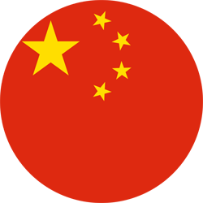

France is DANONE's 3rd important market and accounts for 9% of total sales
Industry Understanding | Client Understanding | Problem Definition | Next Steps
Danone was founded by Isaac Carasso in Barcelona, Spain 1919
Yoghurt is the foundation of Danone and was sold to pharmacies
In 1929, Isaac Carasso moved the company from Spain to France
Danone is No.1 in fresh dairy products globally
Danone is No.1 in plant-based products globally
Danone concentrates on Plant-based food and drinks
Danone specializes in sustainable dairy farming
1
2
3

Slide 8
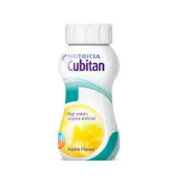




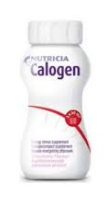


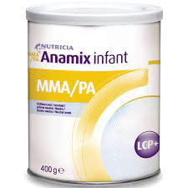


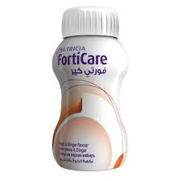

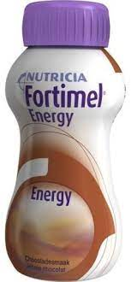

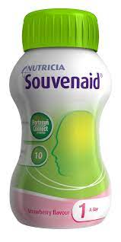
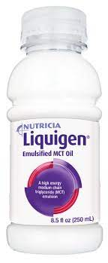
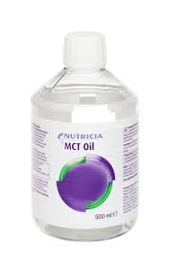
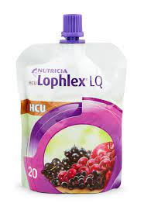
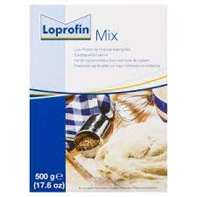


Brands of DANONE nutricia- specialized nutrition
Industry Understanding | Client Understanding | Problem Definition | Next Steps
Infant and Child
Adult
General

Slide 9
Industry Understanding | Client Understanding | Problem Definition | Next Steps
UNDERSTANDING THE MARKET OF SPECIALIZED NUTRITION IN FRANCE
INFANT AND CHILD
ADULT & GENERAL
In infant and child market Bledina-Danone is #1 followed by NESTLE as top baby food competitor
Major spending under adult and general market was on protein shakes constituting 35%

Slide 10



Danone wants to optimize the marketing spend made across each marketing channel
Industry Understanding | Client Understanding | Problem Definition | Next Steps
Understanding the problem
Identify the impact of marketing and provide recommendations to take informed marketing decisions in future
Outcome
Improved marketing budget allocation based on the insights taken from historic data and to achieve high incremental sales
Challenges
Data Availability
Competitor product price
Competitor media spends
Competitor sales
Macroeconomic factors
Diminishing Returns
There will be a stagnation in returns after a certain point due to diminishing returns effect

Slide 11









Marketing Channels used by Danone
Industry Understanding | Client Understanding | Problem Definition | Next Steps
Radio
Newspapers
Instore Marketing
Telephone Marketing
Digital Marketing
Text Message
Offers
Television
Billboards
Above the Line Marketing (ATL)
Through the Line Marketing (TTL)
Below the Line Marketing (BTL)
ATL marketing is used when a brand wants to build awareness and goodwill
TTL marketing is a combination of both ATL and BTL marketing
It provides brand awareness and target potential customers
BTL marketing is used when a brand wants to target potential customers

Slide 12


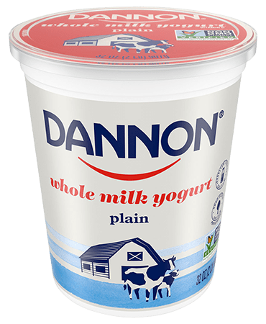



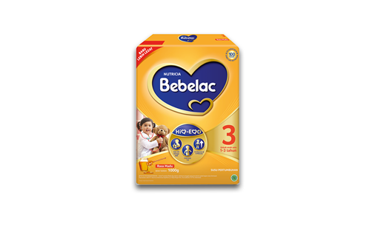

Marketing Behaviors
Industry Understanding | Client Understanding | Problem Definition | Next Steps
ADSTOCK
Lag
We cannot see the result immediately
The influence of an Ad will have a carryover effect on sales for the next few weeks or months
Week 1
Quantity sold
50 tins
Result
Week 2
Advertisement
Delay
25 tins
HALO EFFECT
Week 3
Influence of one product might help in sales of other product
12 tins
Week 4
6 tins

Slide 13



Solution Approach
Industry Understanding | Client Understanding | Problem Definition | Next Steps
Data Presentation
Data Science Layer
Solution
Data
Exploratory Data Analysis
Data Preprocessing
Generate insights on historical marketing performance
Analytical Data Set
ML algorithm to determine the return of investment from historic data
Data Required
Competitor's pricing
Own product pricing
Macroeconomic factors
Advertising spends
Generate recommendations for future marketing spends through response curve
and simulations
Predictive analysis for future marketing performance

Slide 14
THANK YOU

